Slide 1
Memory
Notes:
Thanks to Nisheeth for these slides!

Slide 2
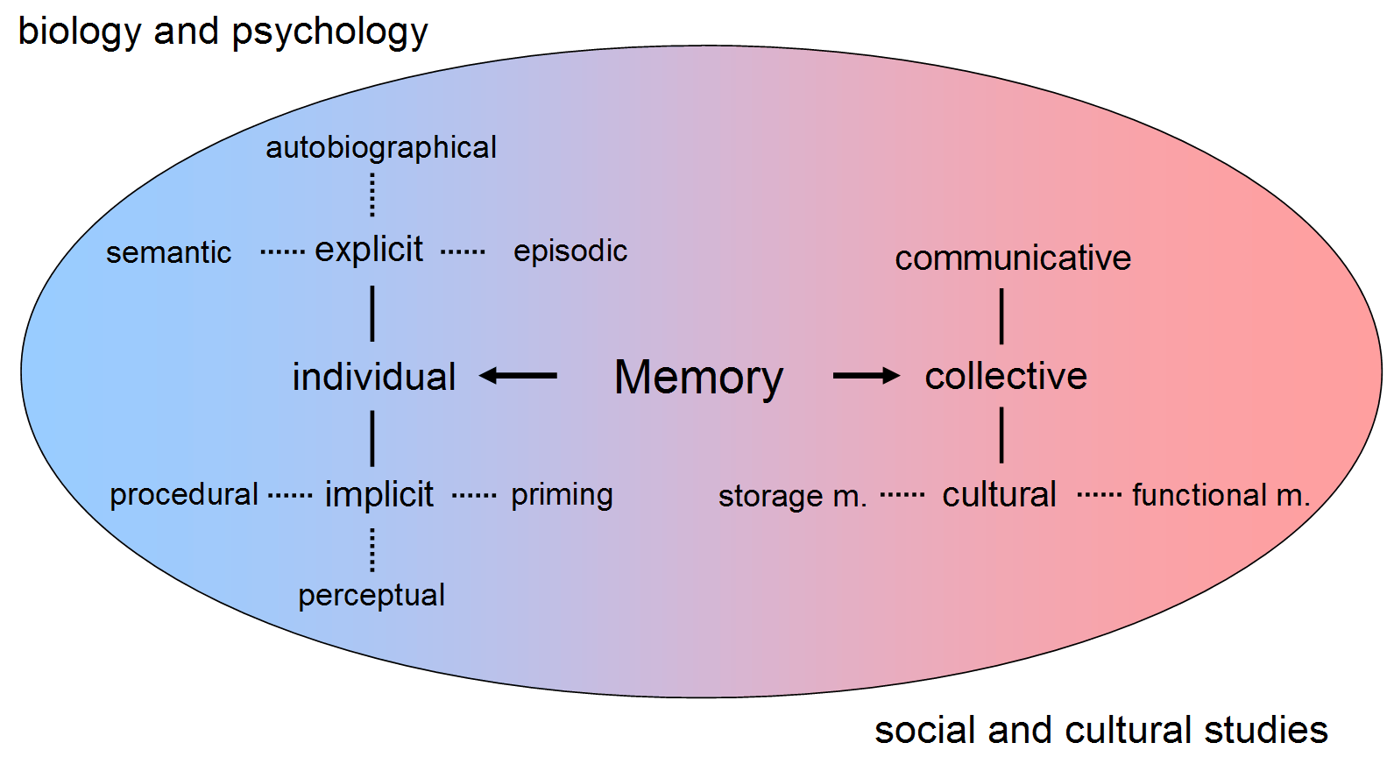
What do we mean by memory?
This module focuses on explicit memory

Slide 3
Explicit memory
Table | Kitten
Candle | Doorknob
Maple | Folder
Subway | Concrete
Pencil | Railroad
Coffee | Doctor
Towel | Sunshine
Softball | Letter
Curtain | Turkey
Player | Hammer
Take two minutes to memorize this list

Slide 4
What can you remember?
Table
Candle
Kitten
Player
Turkey
Hammer
….

Slide 5
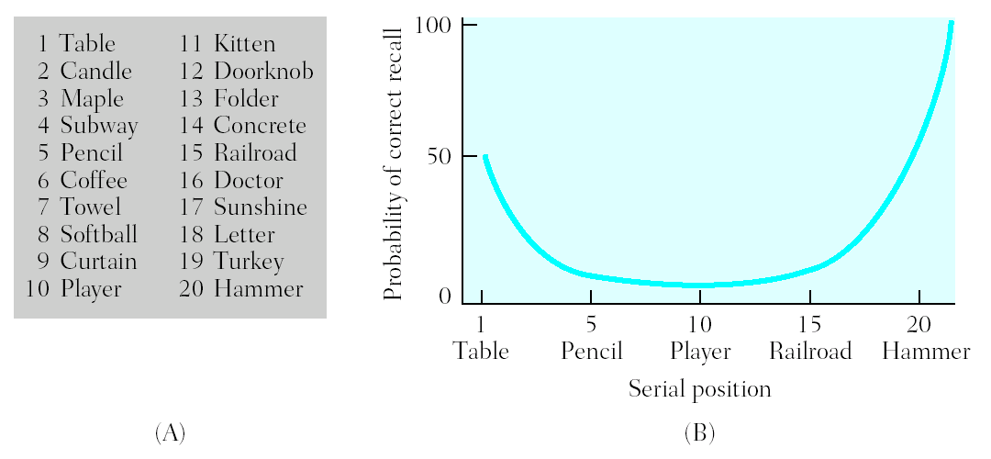
Serial Position Effects
In free recall, more items are recalled from start of list (primacy effect) and end of the list (recency effect)
First items recalled tend to be from end of study list

Slide 6
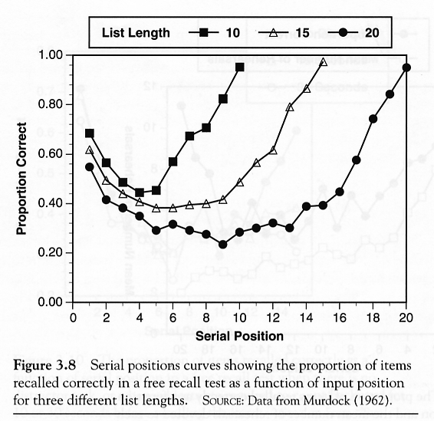
Effects are list-length independent
Modal model explanation for primacy:
early items can be rehearsed more often → more likely to be transferred to long-term memory
Modal model explanation for recency:
Last items of list are still in short-term memory → they can be read out easily from short-term memory
Primacy effect
Recency effect

Slide 7
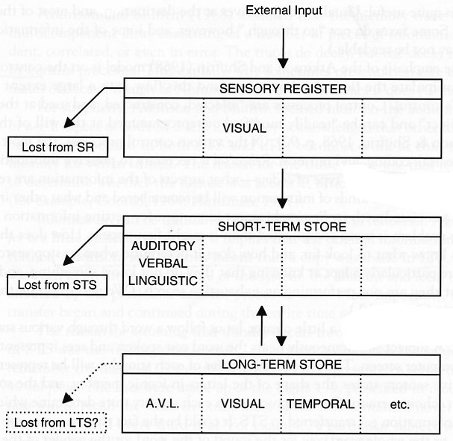
Modal Model of Memory (Atkinson & Shiffrin, 1968)
Short-term memory is a limited capacity store for information -- place to rehearse new information from sensory buffers
Items need to be rehearsed in short-term memory before entering long-term memory
Probability of encoding in LTM directly related to time in STM

Slide 8
Effects are list-length independent
Modal model explanation for primacy:
early items can be rehearsed more often → more likely to be transferred to long-term memory
Modal model explanation for recency:
Last items of list are still in short-term memory → they can be read out easily from short-term memory
Primacy effect
Recency effect

Slide 9
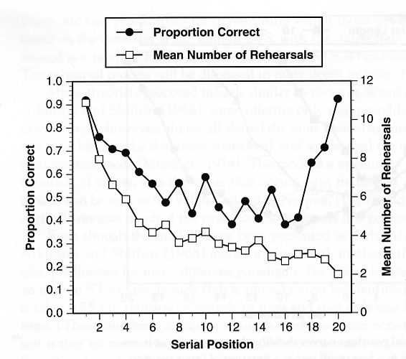
Other observations
There should be more rehearsal for early items
Have subjects rehearse overtly
(Rundus & Atkinson, 1970)

Slide 10
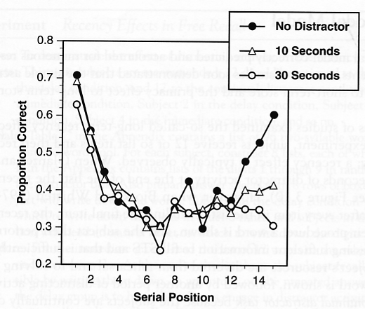
Other observations
Recency effect should disappear with delay.
During delay, contents of STS should be lost
(Glanzer & Cunitz, 1966)

Slide 11
The modal model’s components
Views memory as composed of three relatively distinct stages
Sensory
Short-Term
Long-Term

Slide 12
Sensory Memory
Consists of a set of five registers (temporary storage places, one from each sense) for incoming sensory information from the physical environment until we attend to it, interpret it, and it proceeds to the next stage of memory (short-term memory)

Slide 13
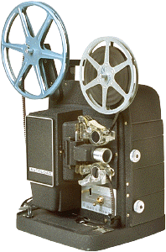
Iconic Memory
Is an exact copy of visual information
Less than a second in duration
Very large capacity
Consider the example of a cartoon movie, which is nothing more than a series of still drawings flashed in rapid succession
Iconic memory allows us to perceive motion in the drawings

Slide 14
Testing Iconic Memory
Sperling’s full- and partial-report procedures present participants with a different 3 x 3 matrix of unrelated consonants (a total of 9) for 50 ms across numerous experimental trials
Here is an example:
L Z Q
R B P
S K N

Slide 15
Testing Iconic Memory
In the full-report procedure participants had to report the entire matrix
Participants said they sensed the entire matrix but that it had faded from memory before they could report all 9 letters

Slide 16
Testing Iconic Memory
In the partial-report procedure, the participants had to report only one row of the matrix, a row indicated by an auditory cue on each trial
When the auditory cue was given immediately after the brief presentation of the letter matrix, participants recalled the indicated row 100% of the time
When there was a one second delay between presentation of the matrix and the auditory cue, participants’ recall of the cued row worsened

Slide 17
Short-Term Memory
Is the memory stage in which the recognized informa-tion from sensory memory enters consciousness
It is where you are doing your present conscious cognitive processing
Serves as a place to rehearse information so it can be transferred to long-term memory and as a place to bring information from long-term memory when asked to recall it
Must concentrate on information in short-term memory or it will be lost in 30 seconds

Slide 18
Capacity of Short-Term Memory
The memory span task tests for the capacity of short-term memory by giving a series of items one at a time
The person has to remember the items in the order in which they were presented
Memory span is the average number of items you can remember across a series of memory span trials
Humans have a memory span of 7+/- 2 (5 to 9) chunks of information
A chunk is a meaningful unit of information
Experts in a given domain tend to have larger chunks for information in their area of expertise

Slide 19
Chunks in short-term memory
BZTK
DJRNQP
MTXHVLFCSR
FROGBATPIGDUCK

Slide 20
Duration of Short-Term Memory
Measured using distractor and span tasks, e.g.
people are given a small amount of information (e.g., three unrelated consonants such as CWZ)
immediately distracted from concentrating on the information for a brief time period (by counting backwards aloud by 3’s)
asked to recall the information
To keep information in short-term memory, we use maintenance rehearsal (i.e., repeating information in short-term memory to keep in from fading from short-term memory)

Slide 21
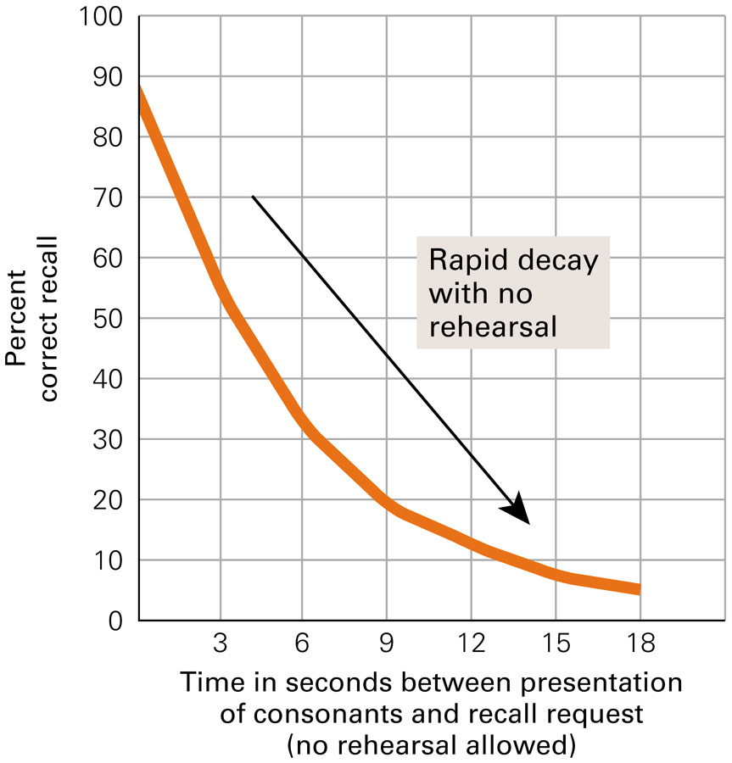
Results for the Short-Term Memory Distractor Task

Slide 22
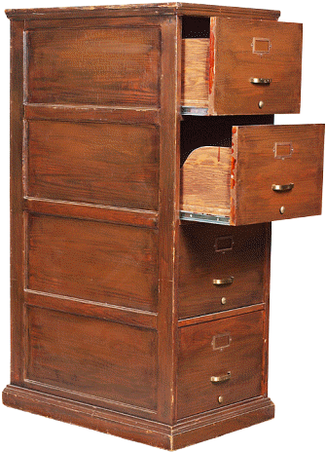
Long-Term Memory
Allows storage of information for a long period of time (perhaps permanently) and its capacity is essentially unlimited

Slide 23
Types of Long-Term Memory
Explicit memory (also called declarative memory) is long-term memory for factual knowledge and personal experiences and requires conscious recall
Two types of explicit memories:
Semantic memories are memories for factual knowledge that is true of everyone (e.g., the current President of the United States)
Episodic memories are memories for personal life experiences (e.g., your senior prom night)

Slide 24

Types of Long-Term Memory
Implicit memory (also called non-declarative memory) is long-term memory that influences our behavior, but does not require conscious awareness or declarative statements (e.g., for most adults, driving a car; walking)
Some implicit memories are procedural memories because they have a physical procedural aspect to them
For a tennis expert the movements to play the game are implicit, procedural memories, whereas for the average person, such movements require conscious recall, and are more semantic memories
Other implicit memories have become automatic responses to certain stimuli

Slide 25
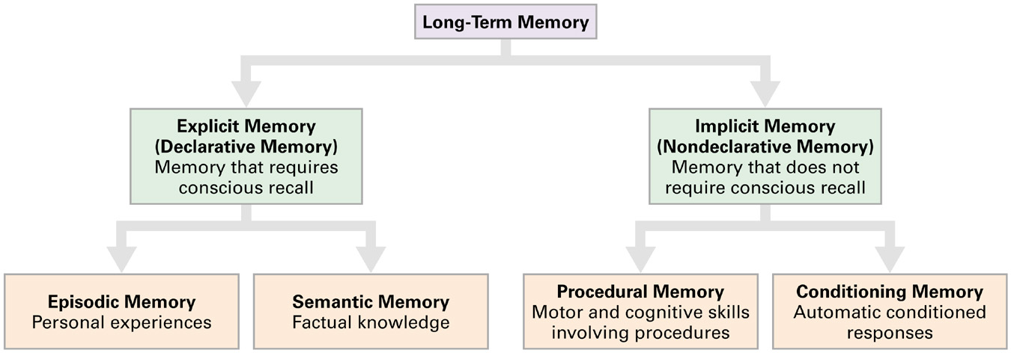
Types of Long-Term Memory

Slide 26
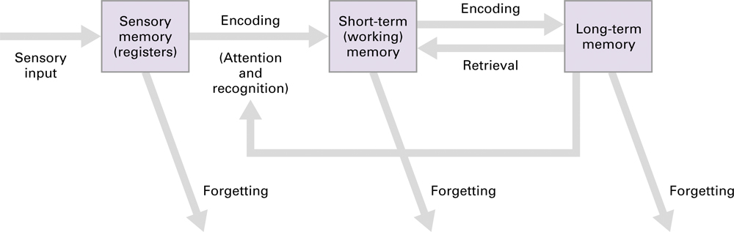
The modal model

Slide 27
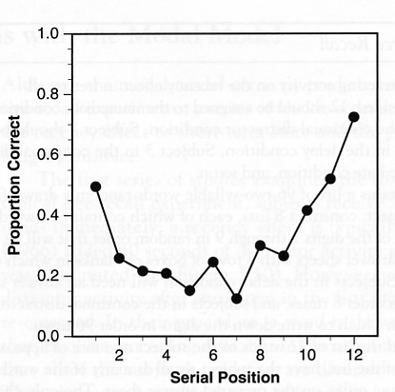
Problems with Modal model (1)
The recency effect re-appears with distractor activity after every list item, including the last item
Addressed by the temporal context model (Sederberg & Kahana, 2008)
(Watkins, Neath & Sechler, 1989)

Slide 28
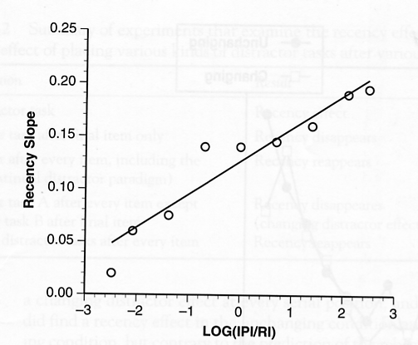
Problems with Modal model (2)
Long-term “recency” effects can occur even after weeks – STS contents should be lost by then
Size of recency effect depends on the relative duration of retention interval (RI) to interitem presentation interval (IPI)
(Nairne, Neath, Serra, & Byun, 1997)

Slide 29
Problems with Modal model (3)
STS “knows” the identity of items coming from the sensory register
How does it know?
The sensory register has to make to make contact with LTS → model loses appealing simplicity

Slide 30
Models of memory

Slide 31
Random access memory
Computer memory can be randomly accessed given address locations
RAM
Address in
Data out
But human memory doesn’t have consistent physical addressing. So how does it still work effectively?

Slide 32
Content addressable memory
Content addressable memories are used in some high-speed search operations
CAM
Data in
Address out
Human memory is closer to content addressable than random addressable
https://en.wikipedia.org/wiki/Content-addressable_memory

Slide 33
Retrieval depends on joint encoding
“Neurons that fire together wire together” – Hebbian postulate
Any memory encoding must store both the target to be stored and the cue that will trigger its retrieval
Can’t store single items in memory
But what are retrieval cues?
Hard to identify in natural settings
Hard to nail down even in experimental settings
In principle, could be any datum of experience

Slide 34
Encoding experiences in memory
Not as straightforward as putting things in boxes and taking them out later
How is the experience represented?
How is it indexed?
How is it retrieved?
What factors affect encoding?

Slide 35
Environmental Effects on Encoding
Encoding specificity principle proposes that the cues present during encoding serve as the best cues for retrieval
This is why elaborative rehearsal helps memory performance
Elaborative rehearsal → plant: tree :: sea: o____, generating targets helps in retention
State-dependent memory is memory that depends upon the relationship of one’s physiological state at the time of encoding and at the time of retrieval
Relationship of smell to memory is a common literary trope, see c.f. Proust’s Remembrance of things past

Slide 36
Environmental Effects on Encoding
Mood-dependent memory effects attest to the fact that memory is better when a person’s mood is the same during encoding and retrieval
For example, if you are happy during encoding information, it is easier to retrieve that information if you are happy at the time of retrieval
Mood-congruence effect is the fact that memory is better for experiences that are congruent with a person’s current mood
For example, when we are sad it is easier to retrieve negative events in our lives

Slide 37
Encoding Specificity
– When conditions of retrieval are similar to conditions of encoding, retrieval is more likely to be successful
– You are more likely to remember things if the conditions under which you recall them are similar to the conditions under which you learned them

Slide 38
Encoding Specificity
Context effects—environmental cues to recall
State dependent retrieval—physical, internal factors
Mood Congruence—factors related to mood or emotions

Slide 39
Encoding-dependent memory tricks
The spacing effect (or distributed study effect) shows that your memory will improve if you study for an exam over an extended time interval rather than just a few days before the exam
Can be because studying in a diverse set of circumstances makes more retrieval cues accessible for encoding
Overlearning is studying material past the point of initial learning, and has been demonstrated to aid in retrieval of that information
Can be because multiple retrieval cues are associated with the same target, aiding retrieval

Slide 40
Measuring memory performance
Recall is a measure of retrieval that requires the reproduction of the information with essentially no retrieval cues
Typical measure = # of items successfully retrieved/# of items on list
Recognition is a measure of retrieval that only requires the identification of the information in the presence of retrieval cues
Typical measure = d’ in n-AFC with n-1 non-targets
Relearning, also called the savings method, is a measure of the amount of time saved when learning the information for a second time

Slide 41
Why do we forget?
Sensory memory
The senses momentarily register
amazing detail
Forgetting can occur at any memory stage
Short-term memory
A few items are both noticed
and encoded
Long-term storage
Some items are altered or lost
Retrieval from long-term memory
Depending on interference, retrieval
cues, moods, and motives, some
things get retrieved, some don’t
Notes:
Hockenbury slides (Schulman)
key words: forgetting

Slide 42

Why We Forget
Encoding failure : sometimes forgetting is not really forgetting, information never entered long-term memory in the first place
Storage decay theory suggests that forgetting occurs because of a problem in the storage of the information
The biological trace of the memory gradually decays over time and the periodic usage of the information helps to maintain it in storage
Highly recommended extra work: watch Inside Out

Slide 43
A classic relearning experiment
Ebbinghaus conducted the first experimental studies on human memory more than 100 years ago using the relearning method.
He would study a list of nonsense syllables until he could correctly recite the complete list without any hesitations. He then put the list aside and waited some period of time and then relearned the list to the same criterion.
To get a measure of learning, he computed a savings score – the reduction in the number of trials it took him to reach criterion.
Result? The “forgetting curve” reveals that most forgetting occurs in the first two days after learning material.

Slide 44
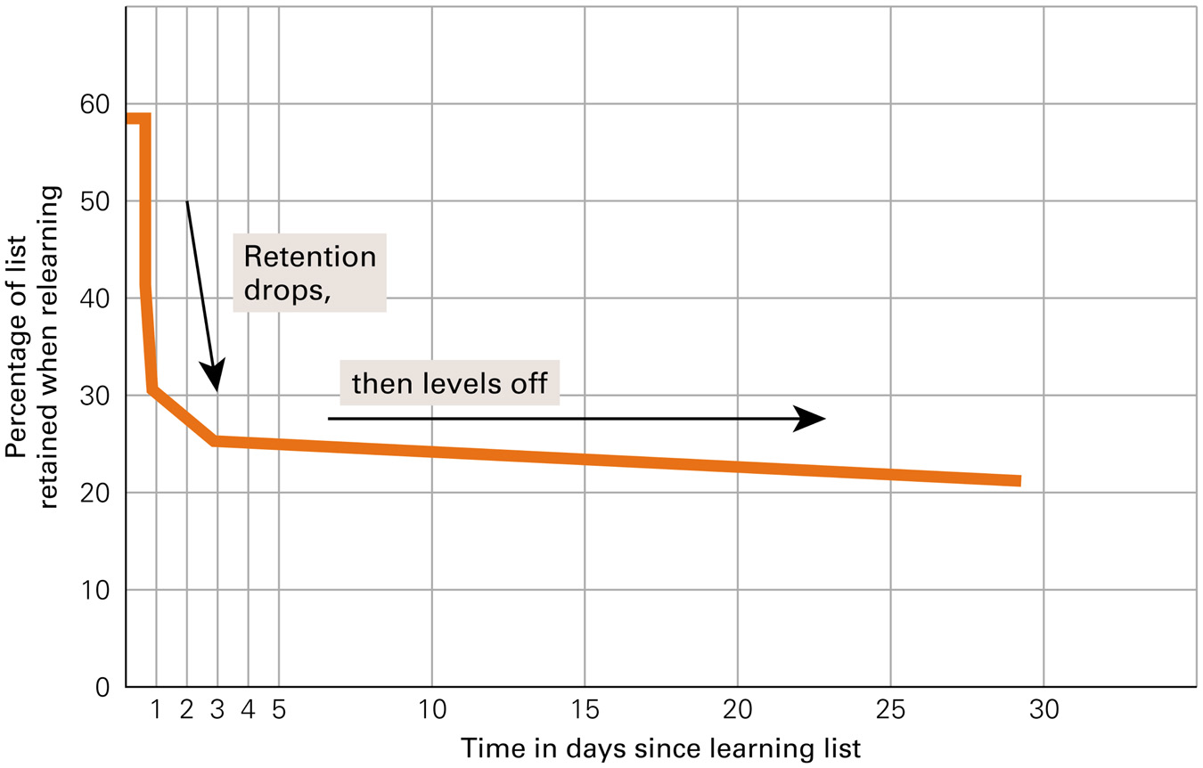
Forgetting Curve for Long-Term Memory

Slide 45
Decay Theories
100%
Memories fade away or decay gradually if unused
Time plays critical role
Ability to retrieve info declines with time after original encoding
Lately subsumed quite well by cue-dependent forgetting theories
Average
percentage of information
retained
20
mins
1
hr
8
hrs
24
hrs
2
days
6
days
31
days
Interval between original learning of nonsense syllables and memory test

Slide 46
Why We Forget
Cue-dependent theory says we forget because the cues necessary for retrieval are not available
The information is in memory, but we cannot access it
This theory is analogous to knowing a book is in the library but you cannot access it because the library lacks call numbers
Interference theory proposes that other similar information interferes and makes the forgotten information inaccessible

Slide 47
Types of Interference
Proactive interference occurs when information you already know makes it hard to retrieve newly learned information
Retroactive interference occurs when information you just learned makes it hard to retrieve old information

Slide 48
Types of Interference
Think about changing phone numbers after having a certain number for many years. When asked for your new phone number, remembering the old one interferes with retrieving the new one.
This is proactive interference
Now think about being at a party with many people you don’t know. You meet someone whom you want to talk to later, but after meeting her, you are introduced to many more people. Now, you cannot remember her name.
This is retroactive interference

Slide 49
Search of Associative memory
Modeling these facts together

Slide 50
Elements of memory models
Search
To explain list-length and fan effects
Direct access
To explain rapid true negatives in recognition
Implicit recognition
To explain the mind’s solution to the correspondence problem
https://pdfs.semanticscholar.org/7ebc/6fb776eb2250da7c925946424b9fee37097c.pdf

Slide 51
Modeling retrieval
Search of associative memory (SAM) was the first modern computational model of memory retrieval (Gillund & Shiffrin, 1984)
Assumes that information is stored in a distributed manner as memory ‘images’
Images contain item, associative and contextual information
Retrieval is modeled as a cue-dependent process
Whether an image is retrieved or not is a function of the associative strengths of the retrieval cues to that image
Single process model of recall and recognition

Slide 52
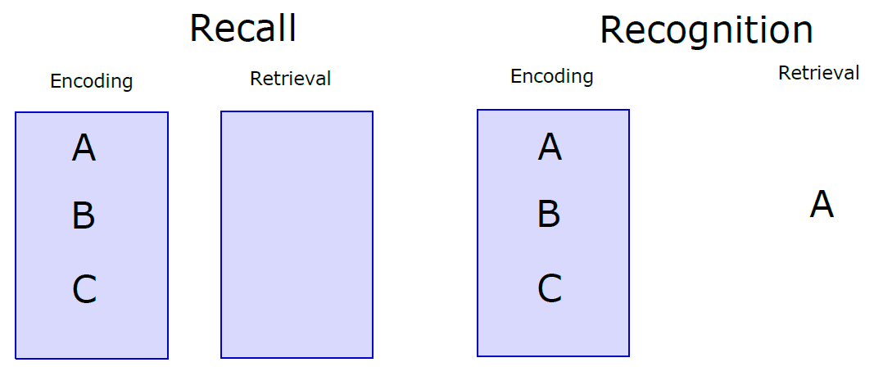
Recognition and recall

Slide 53
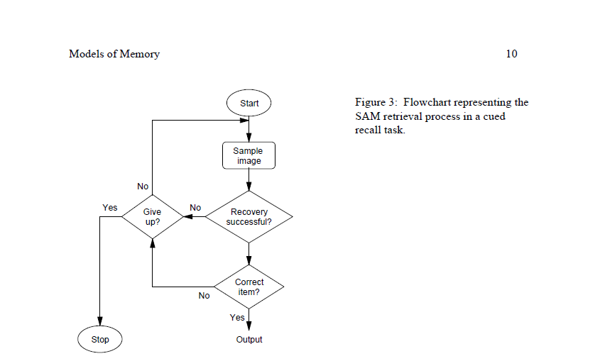
SAM basic idea

Slide 54
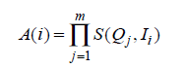
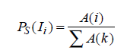
SAM implementation
Assume the retrieval probe contains multiple cues Q₁, Q₂, … Q_{m}
Combined activation of image I_{i} is a multiplicative combination of individual image-cue associations
Probability of sampling an image is a simple Luce choice rule
Not the same as the probability of successful memory retrieval
An image may or may not activate recovery of the correct target of retrieval

Slide 55
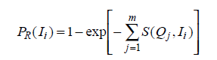
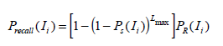
SAM implementation
Probability of successful recovery
Probability of recall success
If attempt succeeds, association between probe cues and sampled image strengthens
SAM had basic learning built into it

Slide 56
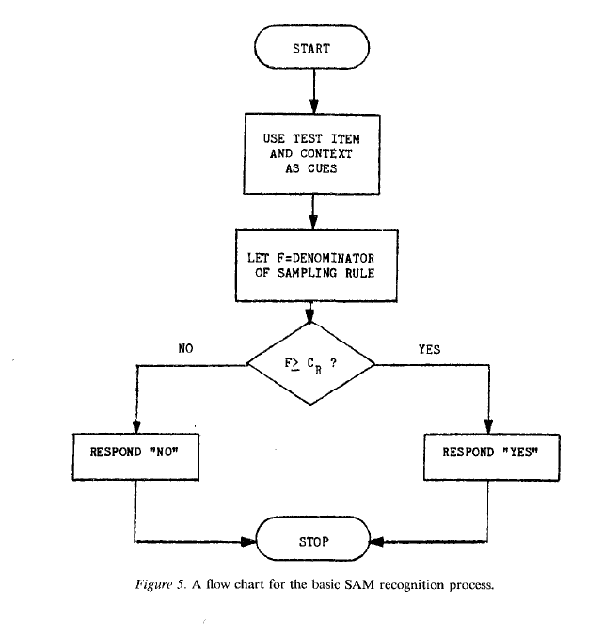
SAM recognition algorithm

Slide 57
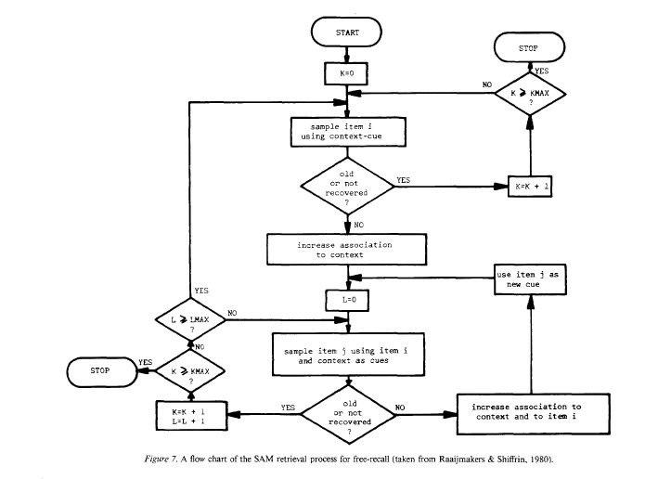
SAM recall algorithm

Slide 58
Successful predictions
List length effects in recall
Probability of sampling an item decreases as the number of items increases
Presentation time effects
Increased presentation time → stronger associations → better recall and recognition
Primacy effects
In recall because of reinforcement of previous samples
In recognition because of the generation of new images corresponding to each successful recognition

Slide 59
Successful predictions
Part set cuing
Cuing set reduces set of items that can be sampled from
This is what the browser experiment is testing
Word frequency effects
Recall prefers high frequency items because they have more associations
Recognition prefers low frequency items because there is a lower variance in the associative strength distribution for LF items

Slide 60
SAM failures
Long term recency effects
Null list length effect in recognition
Empirical list length observations in recognition confounded with time to testing
Recognition memory for up to 10000 images documented (Standing, 1973; Brady et al., 2014)
List strength effect
Strength of items = presentation time
Recognition of strong items in lists of purely strong items better than in mixed lists
Recognition of weak items in lists of purely weak items worse than recognition in mixed lists
Mirror effect
Greater true positives and fewer false positives in recognition of low frequency items

Slide 61
Temporal context model
SAM makes no assumptions about the effect of the environment on retrieval cues guiding the memory process
Accepted as inputs
Recent retrievals can become cues for subsequent retrievals
The temporal context model (TCM) changes this
Assumes a linear drift of the temporal context cue that goes into every episodic memory encoding
Recommended reading: (Howard & Kahana, 2002)

Slide 62
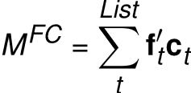
TCM encoding
Items are represented as feature vectors f
Context is also represented as feature vectors c – on a different feature space
Both item and feature vectors are time-indexed
Construct an item-context mapping via an outer product

Slide 63
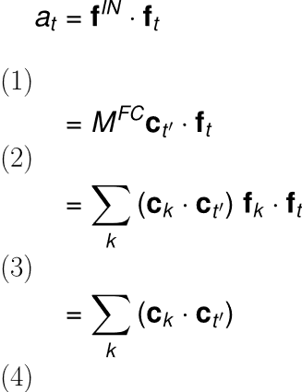
TCM retrieval
Retrieval happens via spreading activation
A state c on C will provide activation input f^{out} = M^{FC} c
Similarity of this input to a given item f can be measured as a dot product
This quantifies the retrieval pull the context exerts on each item
Follows from f orthonormality (assumed)

Slide 64
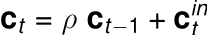
The context drift assumption
Assume a linear drift in context
A little bit like a recurrent network
Naturally makes contexts at closer times more similar than contexts at farther times from the probe point
Yields long-term recency predictions

Slide 65
Search of associative memory
If we can assume that we know the associative strength between all possible targets and cues
We can predict various experimental outcomes in memory experiments
But how do associative strengths get to be the way they are in your head?

Slide 66
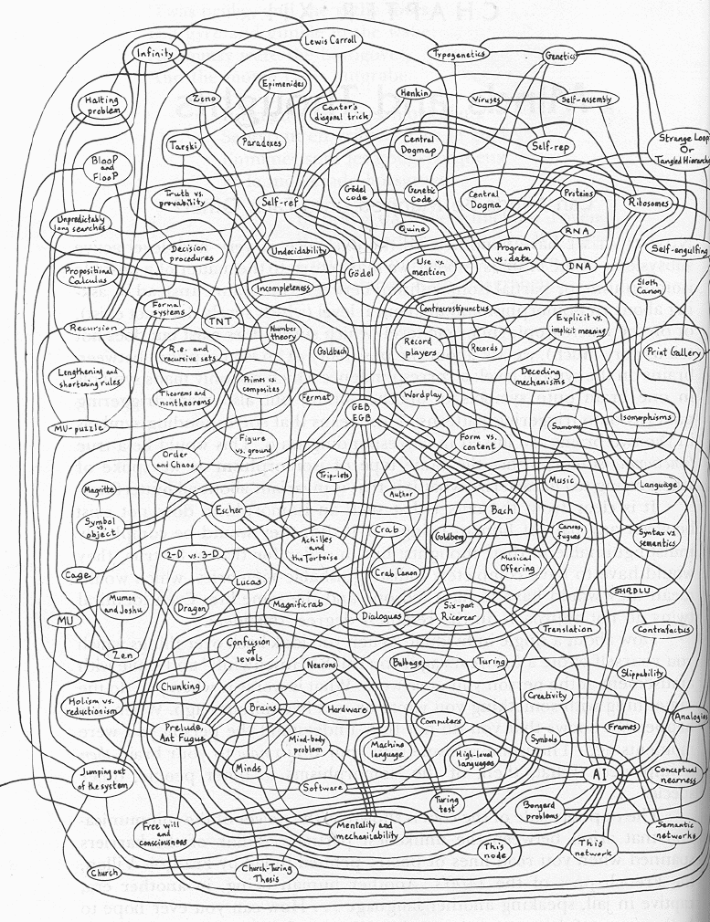
Semantic Networks
Explains everything and predicts nothing
Hofstadter. Godel, Escher, Bach.

Slide 67
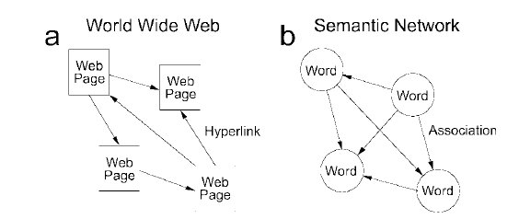
Can we be more precise in dealing with semantic networks?
Griffiths and Steyvers made a great observation
Search in the semantic network has the same information-theoretic constraints as relevance search on the internet
Recommended reading: Griffiths, Steyvers & Firl. Google in the mind.

Slide 68
Basic idea
Use PageRank to predict word completing task performance
PageRank:
Consider the adjacency matrix of all web pages L
Important websites are linked to by other important websites
Consider each link to be transporting some of each website’s importance to the outbound connection
Solve for importance; list websites containing search term in order of importance

Slide 69
Memory hypothesis
All brain areas stimulated by a particular retrieval cue constitute nodes in a graph
Consider the adjacency matrix of this graph, measure in terms of synaptic connectivity
Consider accessibility of a memory engram as the equivalent of website ‘importance’
We have a correspondence between web and memory search

Slide 70
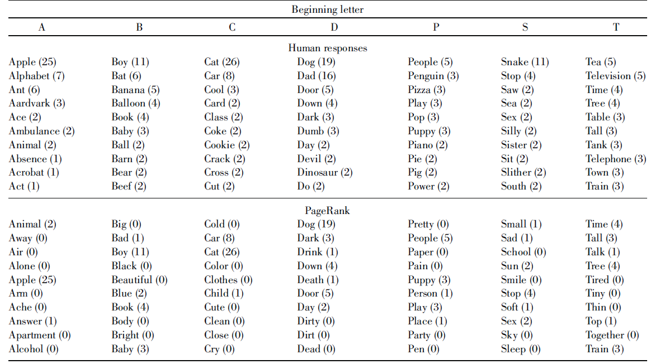
Word completion task
Given a letter, come up with as many words as you can that start with that letter

Slide 71
How to model this?
PageRank-like associativity is the outcome
What is the process?
One possibility
Activation spreads from node to node along associative links
Assume each node spreads its activation equally over all nodes it is connected to
New activation = old activation – decay + inputs

Slide 72
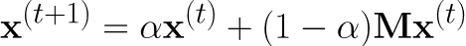
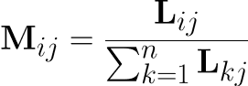
Modeling formally
Assume the vector x is activation for all nodes
Here M is a matrix whose entries are
L are binary outbound links in the graph

Slide 73
Semantic Networks
Can say something about how the semantic network comes about
Spreading activation from node to node brings the graph into its present shape
Some predictions are possible
Hofstadter. Godel, Escher, Bach.

Slide 74
Exploration in the semantic network
Exploration of memory is affected by the familiar exploration-exploitation tradeoff
But how? Search in memory is impossible?
By manipulation of cues
What sort of effect can environmental factors or previous tasks have on memory exploration?
https://warwick.ac.uk/fac/sci/psych/people/thills/thills/2015hillstics.pdf

Slide 75
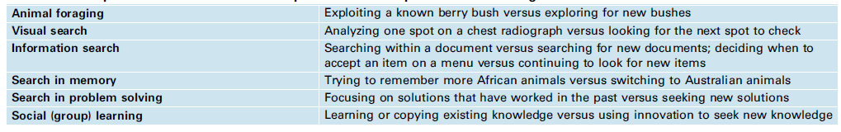
Thomas Hills’ memory search
Optimal foraging theory
Animal spends some time looking for food
When it finds a patch of food, the rate of food acquisition drops over time
Goal is to maximize rate of food accumulation
Optimal theory predicts: shift to a new patch when food acquisition rate drops below global mean

Slide 76
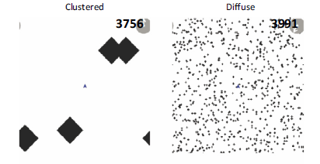
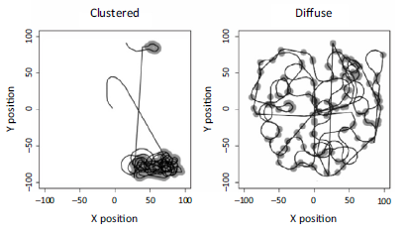
A spatial foraging task
Experimental task: find hidden areas of high reward
Strategies differ

Slide 77
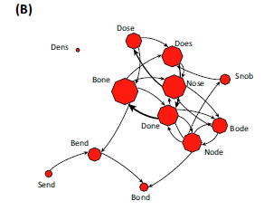
Same participants do a memory task
Scrabble: find all words in the letter set NSBDOE

Slide 78
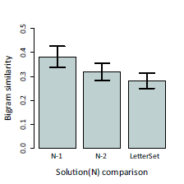
Word production shows sequential dependence

Slide 79
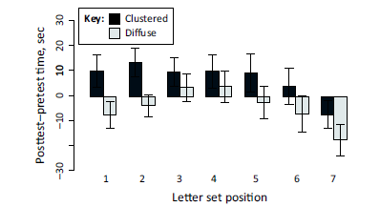
Previous task appears to control exploration propensity
Semantic network traversal is cognitively controllable

Slide 80
More neurobiology of memory

Slide 81
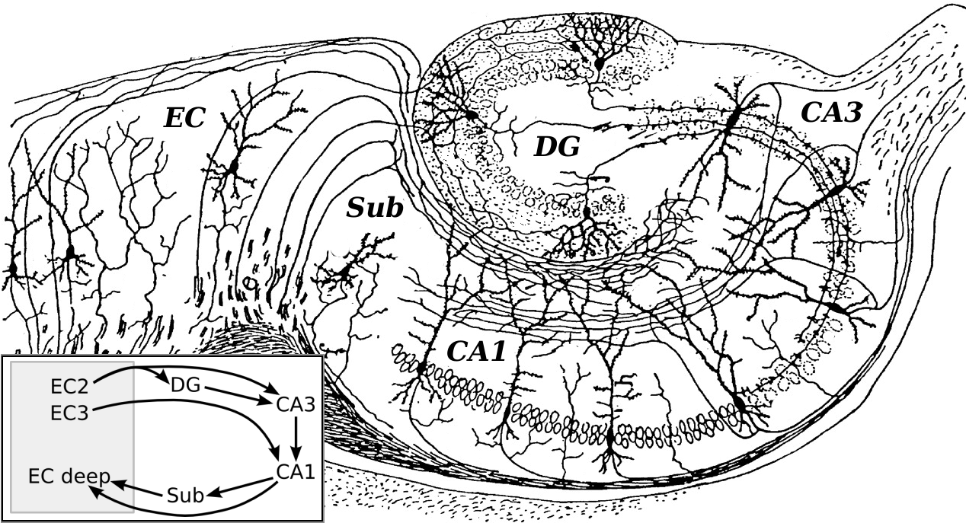
Hippocampus
Phenomenally interesting anatomical structure; crucial for forming representations

Slide 82
Hippocampus
Literally thousands of experiments have been conducted on rat hippocampus
General consensus
Hippocampus is crucial for memory formation
Hippocampus is crucial for spatial navigation
Details remain unknown
Current frontier of computational modeling of cognition
https://www.ncbi.nlm.nih.gov/pmc/articles/PMC4079500

Slide 83
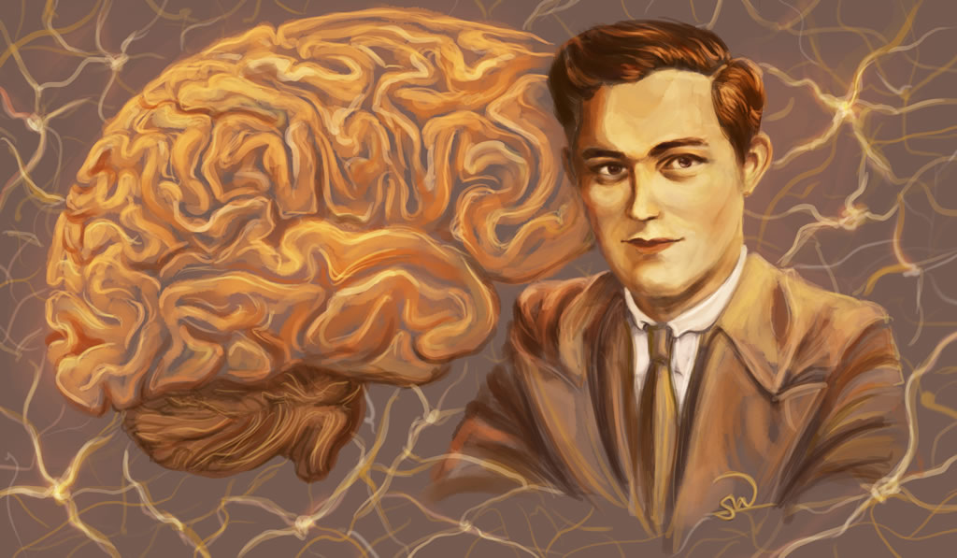

Hippocampus as the seat of memory
Identified by lesion studies as critical for memory formation
Case of H.M.
Dentate gyrus in particular is vital for conjunctive coding of observations
https://en.wikipedia.org/wiki/Hippocampus

Slide 84

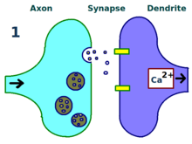
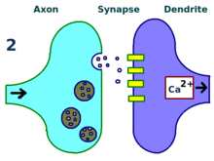
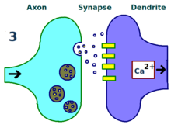
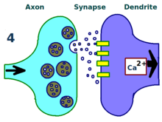
Glutamate receptors and memory function
Glutamate receptors are critical for long-term potentiation (LTP) of neurons
How do glutamate receptors affect the acquisition of a behavioral memory?
This was the question Richard Morris addressed in his classic 1986 paper. This paper was a classic because it was the first to outline an approach to the problem and produce some reasonable data.
https://en.wikipedia.org/wiki/Long-term_potentiation

Slide 85
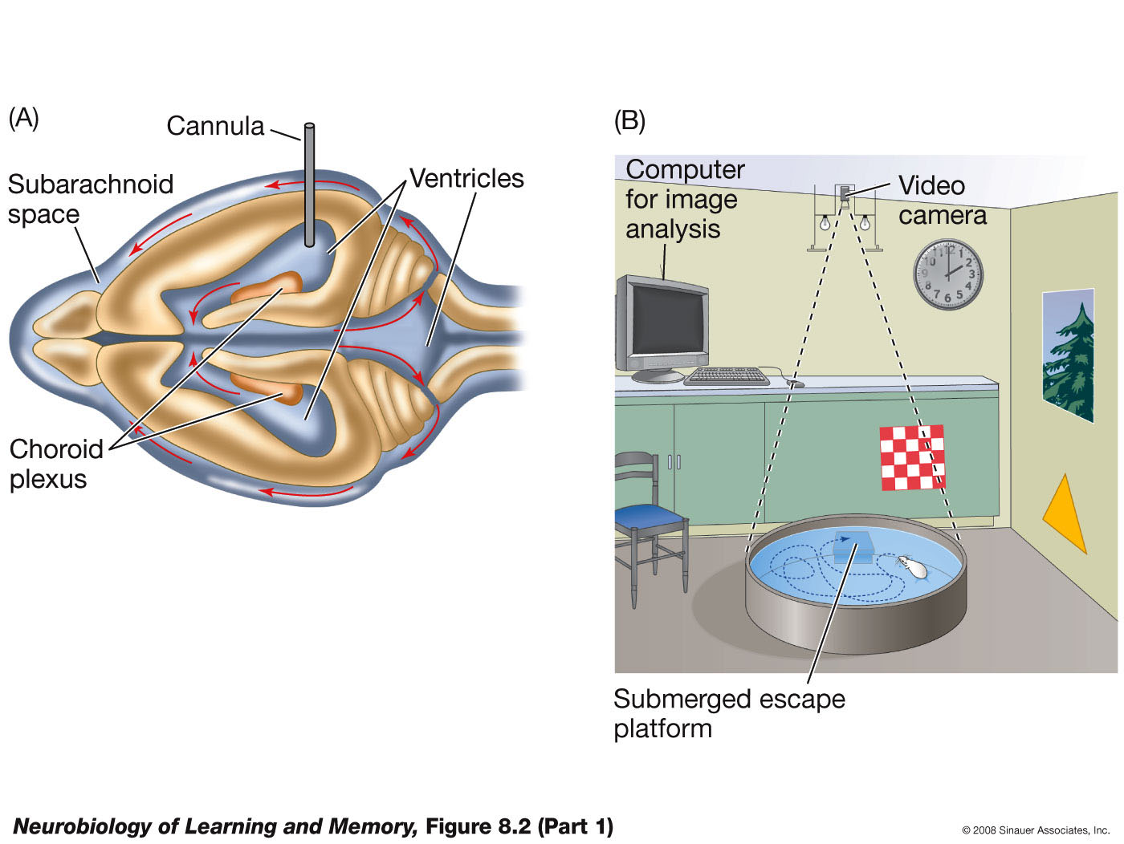
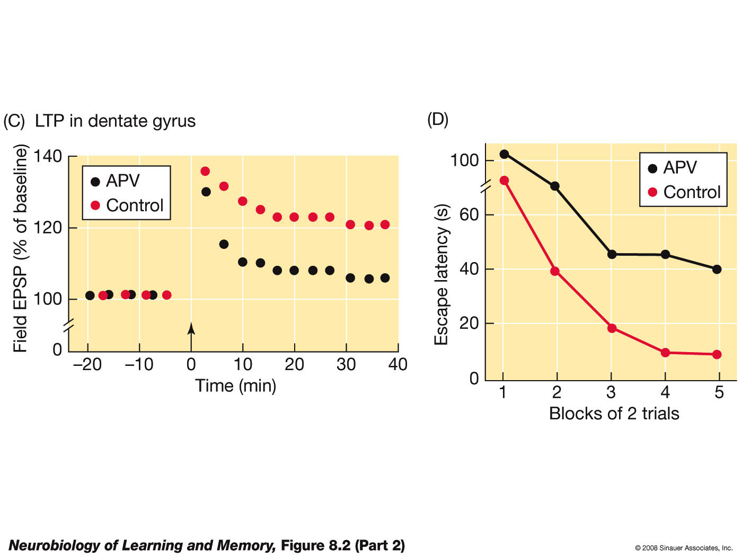
Morris water maze experiment
Notes:
Components of the classic Morris experiment. (A) A cannula was implanted into the ventricles of the rat’s brain and attached to a time-release pellet that contained the NMDA receptor antagonist, APV. (B) Rats were trained on the place-learning version of the water-escape task. (C) Rats infused with APV could not sustain LTP in the dentate gyrus. (D) Rats injected with APV were impaired in learning the location of the hidden platform. (E) Control rats selectively searched the quadrant that contained the platform during training, but rats injected with APV did not. T = training quadrant; A = adjacent quadrant; O = opposite quadrant.

Slide 86
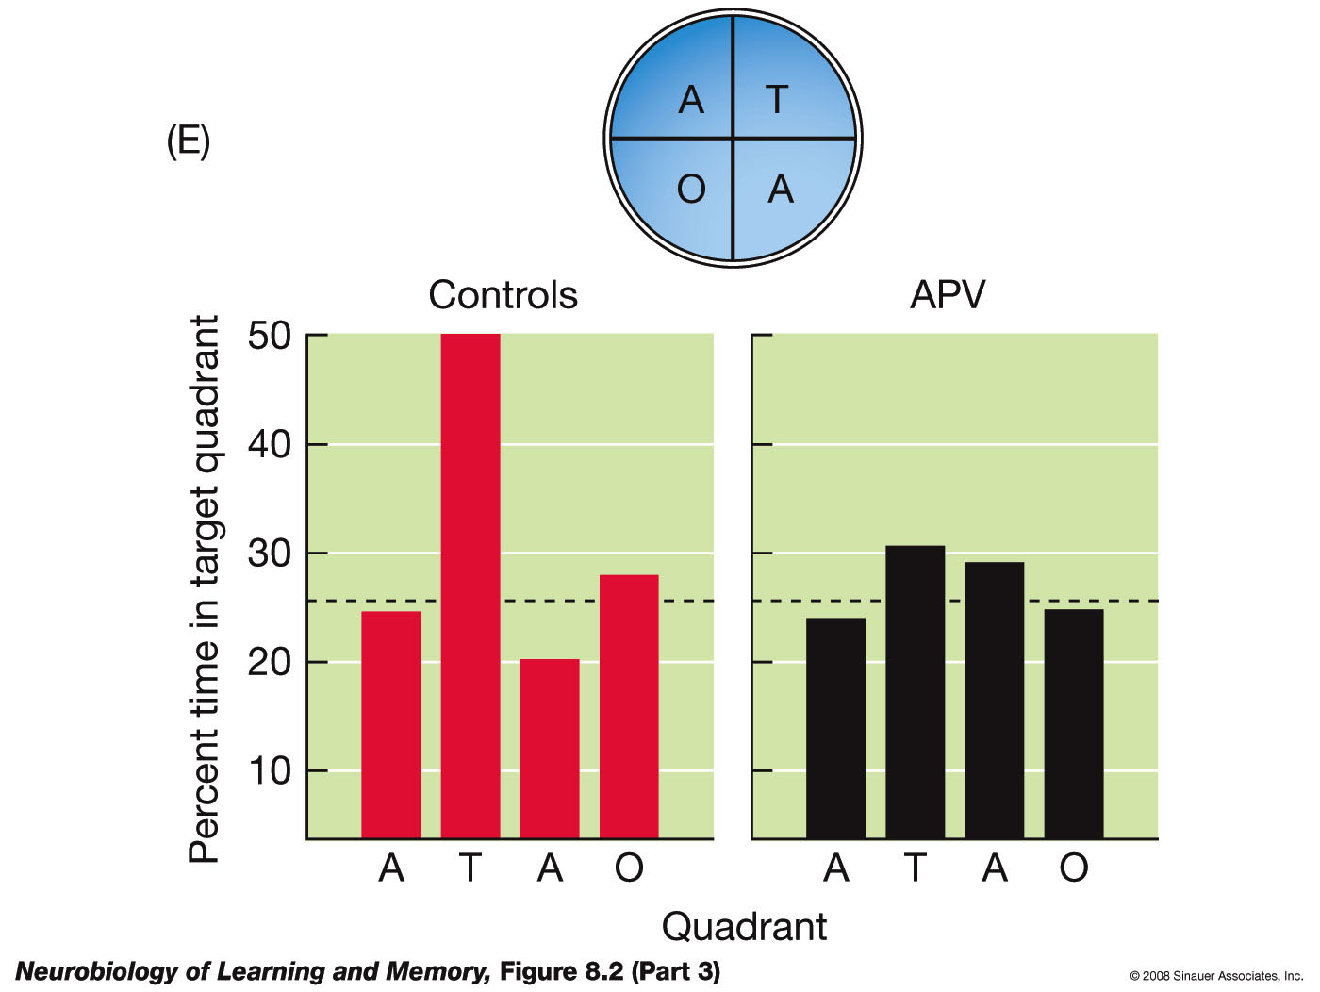
NMDA receptors potentiate place learning
Many of the following slides taken from this book’s corresponding slide deck
Notes:
Components of the classic Morris experiment. (A) A cannula was implanted into the ventricles of the rat’s brain and attached to a time-release pellet that contained the NMDA receptor antagonist, APV. (B) Rats were trained on the place-learning version of the water-escape task. (C) Rats infused with APV could not sustain LTP in the dentate gyrus. (D) Rats injected with APV were impaired in learning the location of the hidden platform. (E) Control rats selectively searched the quadrant that contained the platform during training, but rats injected with APV did not. T = training quadrant; A = adjacent quadrant; O = opposite quadrant.

Slide 87
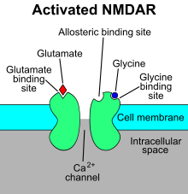
How do glutamate receptors work?
Neurotransmitter is the agonist for a receptor
Activated receptor allows cation flow
NMDA gates calcium channels
If enough receptors are activated, enough cations flow to cause an action potential (firing event)
https://en.wikipedia.org/wiki/NMDA_receptor

Slide 88
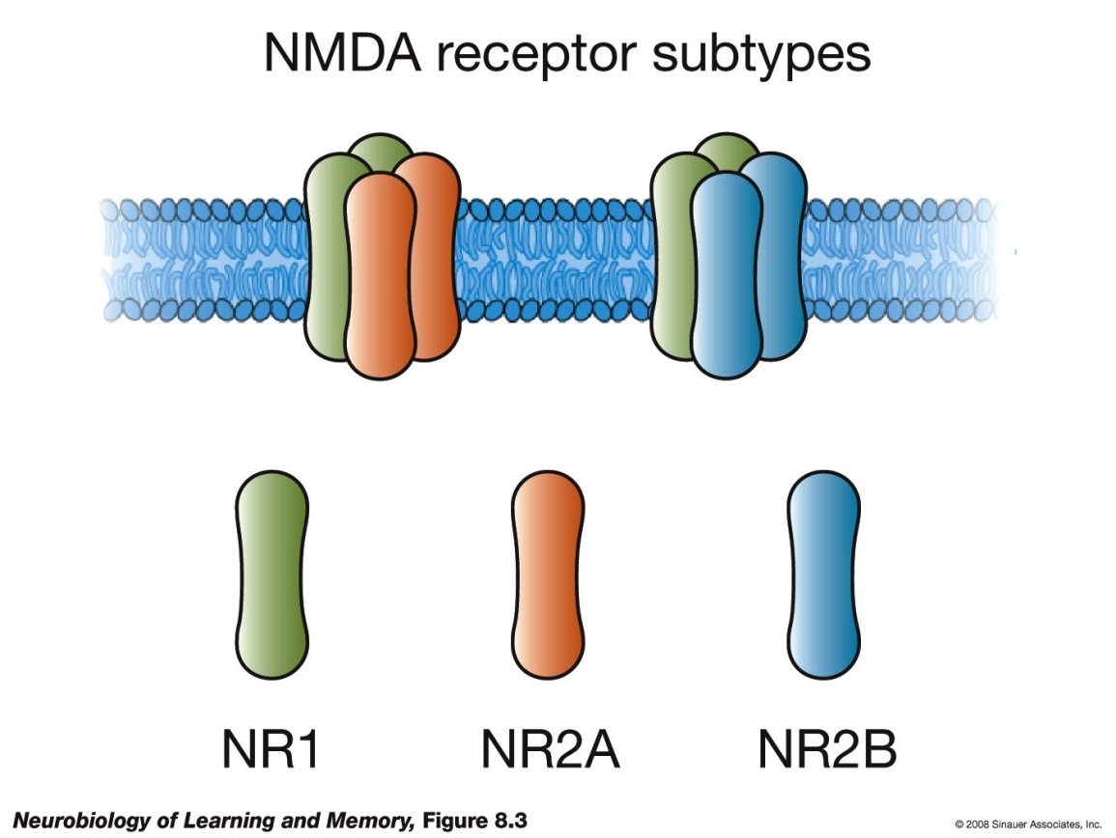
NMDA experiments
NMDA receptors are composed of NR1 and NR2 subunits. All functional receptors contain NR1 subunits. NR2 subunits come in two categories, NR2A and NR2B.
Notes:
NMDA receptors are composed of four subunits. All functional NMDA receptors contain NR1 subunits. There are a variety of NR2 subunits. This figure illustrates NMDA-receptor complexes composed of NR1–NR2A and NR1–NR2B subunits.

Slide 89

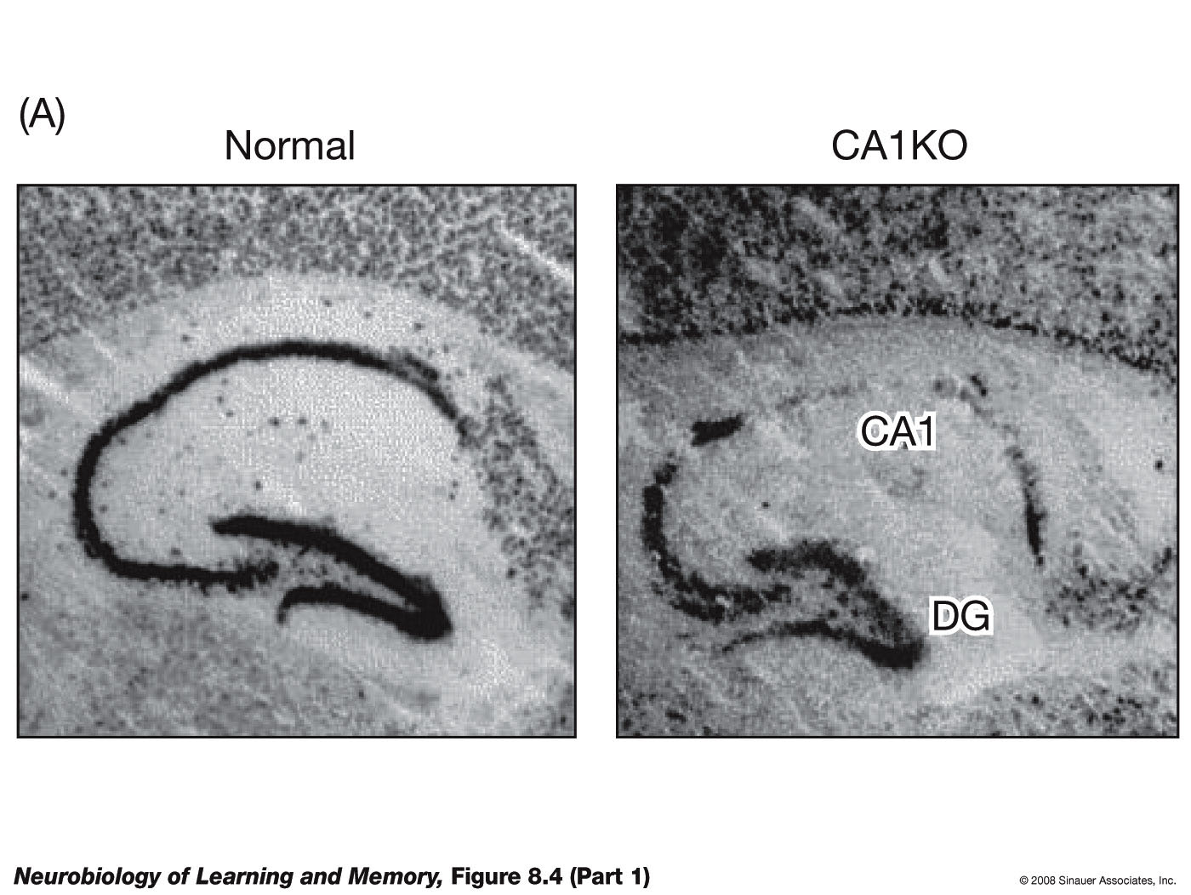
Removing a subunit
Notes:
(A) This photomicrograph shows a section of a normal hippocampus (left section) that has been stained to reveal the presence of the NR1 subunit. Note that the NR1 subunit is absent in the CA1 region of the section taken from the genetically engineered mouse, called a CA1 knockout or CA1KO (right section), but is present in the dentate gyrus (DG). (B) LTP cannot be induced in CA1 in slices taken from mice lacking the NR1 subunit. (C) LTP can be induced in the dentate gyrus in slices taken from the genetically engineered mice because the NR1 subunit is still present. (D) The CA1KO mice are impaired on the place-learning version of the Morris water-escape task. (E) These mice also do not selectively search the training quadrant on the probe trial. (After Tsien et al., 1996.)

Slide 90
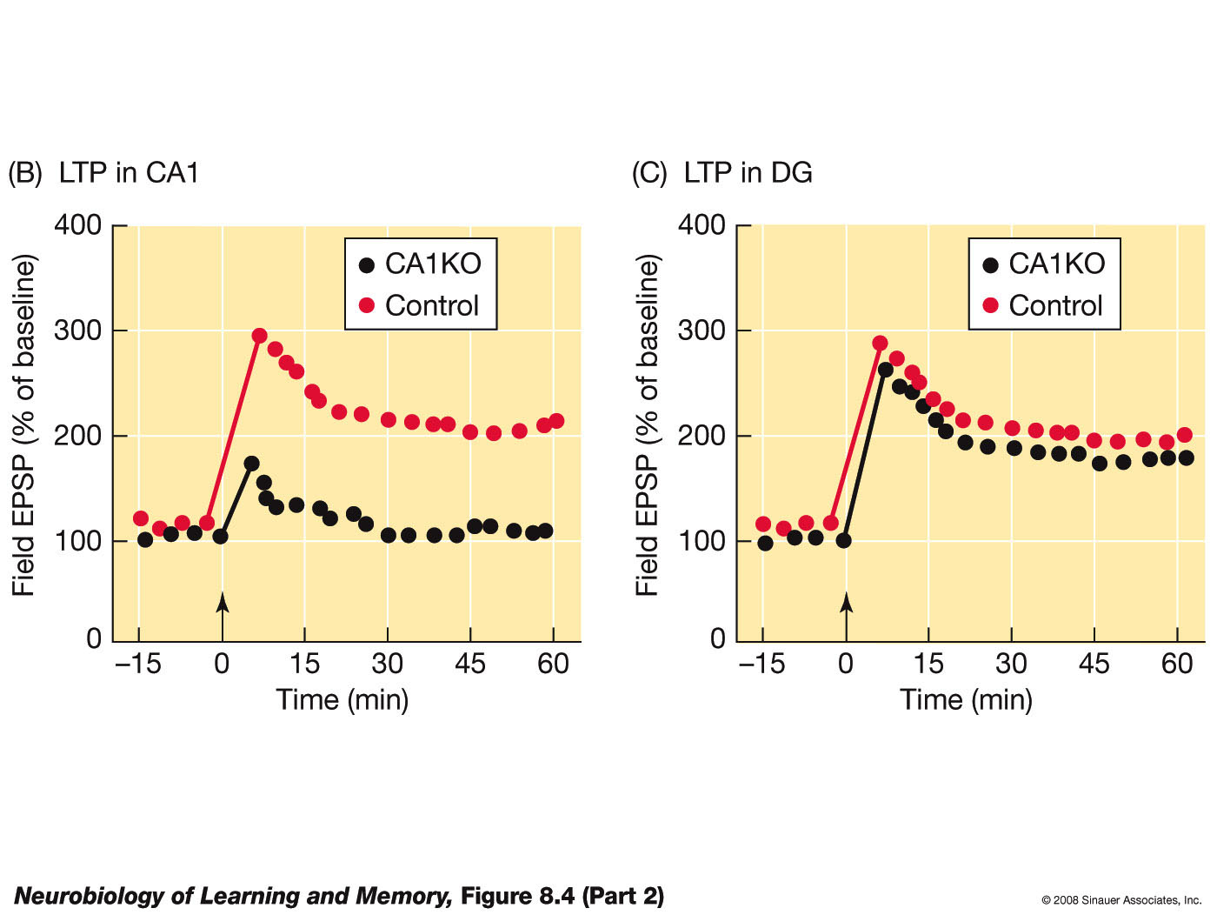
Removing a subunit
Notes:
(A) This photomicrograph shows a section of a normal hippocampus (left section) that has been stained to reveal the presence of the NR1 subunit. Note that the NR1 subunit is absent in the CA1 region of the section taken from the genetically engineered mouse, called a CA1 knockout or CA1KO (right section), but is present in the dentate gyrus (DG). (B) LTP cannot be induced in CA1 in slices taken from mice lacking the NR1 subunit. (C) LTP can be induced in the dentate gyrus in slices taken from the genetically engineered mice because the NR1 subunit is still present. (D) The CA1KO mice are impaired on the place-learning version of the Morris water-escape task. (E) These mice also do not selectively search the training quadrant on the probe trial. (After Tsien et al., 1996.)

Slide 91
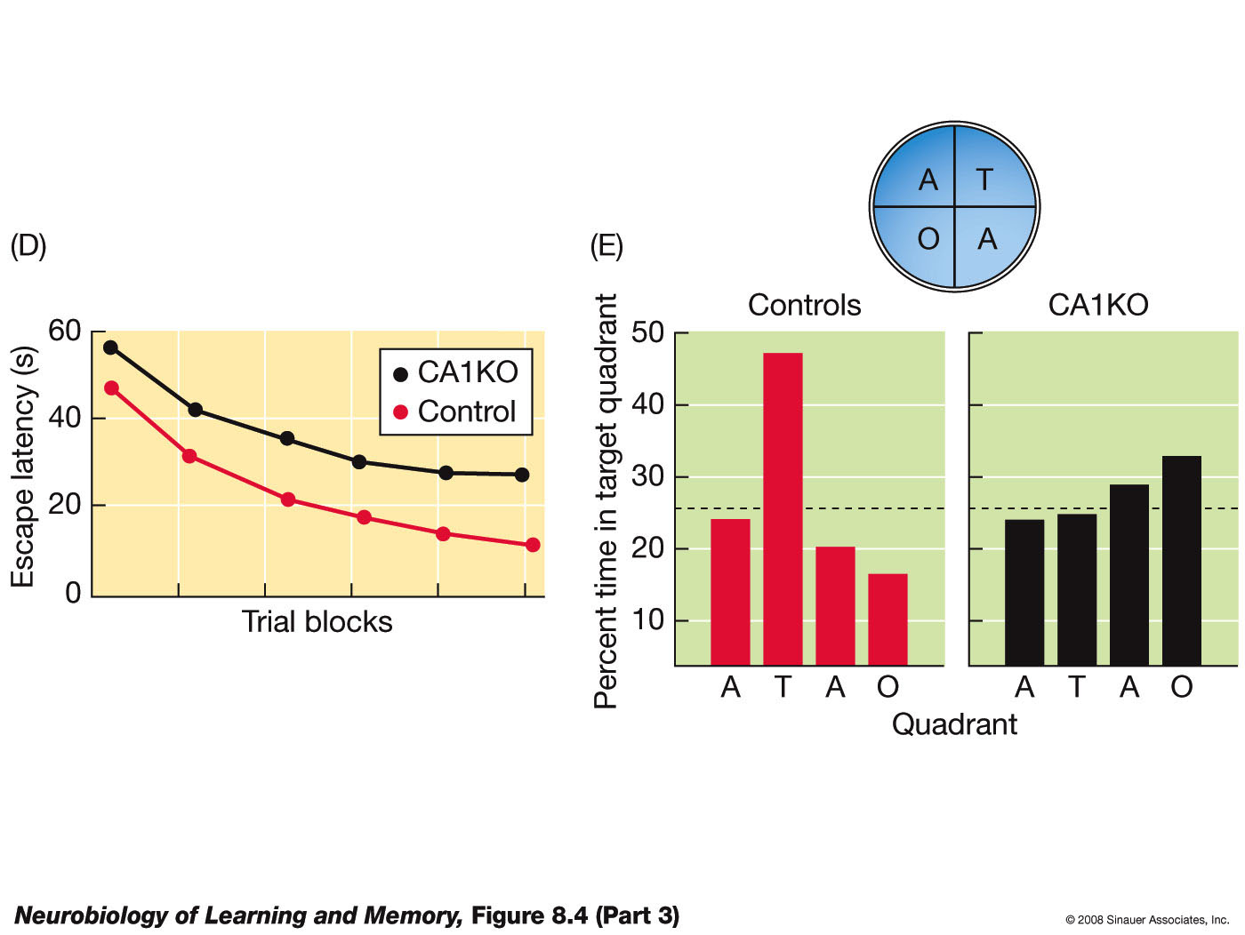
Removing a subunit
Notes:
(A) This photomicrograph shows a section of a normal hippocampus (left section) that has been stained to reveal the presence of the NR1 subunit. Note that the NR1 subunit is absent in the CA1 region of the section taken from the genetically engineered mouse, called a CA1 knockout or CA1KO (right section), but is present in the dentate gyrus (DG). (B) LTP cannot be induced in CA1 in slices taken from mice lacking the NR1 subunit. (C) LTP can be induced in the dentate gyrus in slices taken from the genetically engineered mice because the NR1 subunit is still present. (D) The CA1KO mice are impaired on the place-learning version of the Morris water-escape task. (E) These mice also do not selectively search the training quadrant on the probe trial. (After Tsien et al., 1996.)

Slide 92

Maturation affects NMDA composition
This figure illustrates the shift in the ratio of NR1–NR2A and NR1–NR2B NMDA receptors that takes place as the brain develops. Top: During the early postnatal period there are relatively more NR1–NR2B receptor complexes. Bottom: With maturation there is a shift in the balance so that there are now more NR1–NR2A receptor complexes.

Slide 93


Genetic amplification
Notes:
In the Doogie mouse, the NR1–NR2B NMDA complex is overexpressed in several regions of the brain, including the cortex, hippocampus, and amygdala. (A) Slices from the Doogie mouse show enhanced LTP. (B) The Doogie mouse shows a stable and enhanced memory for a contextual fear-conditioning experience. (Photo provided by J. Z. Tsien.)

Slide 94
Complication
Phase 1
Phase 2
Results
Rats first trained on the task in Room 1.
Rats trained on the task in Room 2 were injected with APV.
LTP in DG was blocked but APV had no effect on place learning. Thus pretraining in a different room abolished the behavioral effects of antagonizing NMDA receptors.

Slide 95
Other limitations
NMDA may be gating processes that support memory among other behavior
Water maze experiments are confounded with
Thigmotaxis (trying to stay in touch with a solid surface)
Mice being smart about outcomes

Slide 96


The role of AMPA receptors
Notes:
Malinow and his colleagues used a special technique to insert modified glutamate receptors, GluR1, into the lateral amygdala. (A) These receptors were labeled with a fluorescent molecule and could be visualized. (B) Rats with these fluorescent-tag AMPA receptors were tested for fear of a tone paired with shock or tested for fear of a tone unpaired with shock. Rats in the paired condition displayed fear to the tone. The rats were then sacrificed and slices were taken from their brains. An analysis of these slices revealed fear conditioning had driven the GluR1 AMPA receptors into the spines. (C) Schematic representation of the distribution of the GluR1 receptors prior to training. (D) After the training, rats in the paired condition had more GluR1 receptors trafficked into the plasma membrane than rats in the unpaired condition. These results indicate that a behavioral experience that produces fear conditioning also drives AMPA receptors into the synapse. (After Rumpel et al., 2005.)

Slide 97


AMPA receptors
Notes:
(A) Modified nonfunctional GluR1 receptors are injected into the lateral amygdala. These modified receptors compete with endogenous functional GluR1 receptors for trafficking into spines. (B) Rats injected with this receptor display impaired fear conditioning to a tone paired with shock. (C) Slices from animals injected with the modified receptor cannot sustain LTP induced in the lateral amygdala. (After Rumpel et al., 2006.)

Slide 98

Amplifying AMPA
Notes:
(A) When glutamate binds to AMPA receptors the conductance channel is briefly opened and this allows positive ions to enter. (B) When ampakines and glutamate both bind to the AMPA receptor, the channel stays open longer and therefore more ions enter and the synaptic response is enhanced. (C) Ampakines enhance the rate of auditory fear conditioning.

Slide 99

Differences between NMDA and AMPA effects
AMPA antagonist affects encoding and retrieval both. NMDA antagonist affects only encoding.
Notes:
The top of this figure is a schematic of the arena Morris and his colleagues used to study the role of glutamate receptors in the acquisition and retrieval of a memory for the location of flavored food pellets. On the retrieval test, the two sand wells that contained the flavored pellets on the acquisition trial were uncovered. The rat was fed one of the pellets in the release point. Its task was to remember which sand well contained that pellet during acquisition. When given before acquisition, both APV and CNQX interfered with establishing the food-location memory. However, only CNQX, the AMPA receptor antagonist, interfered with the retrieval of the memory. Con = control group. (After Day et al., 2003.)

